Slide 1
17: Typography

Slide 2
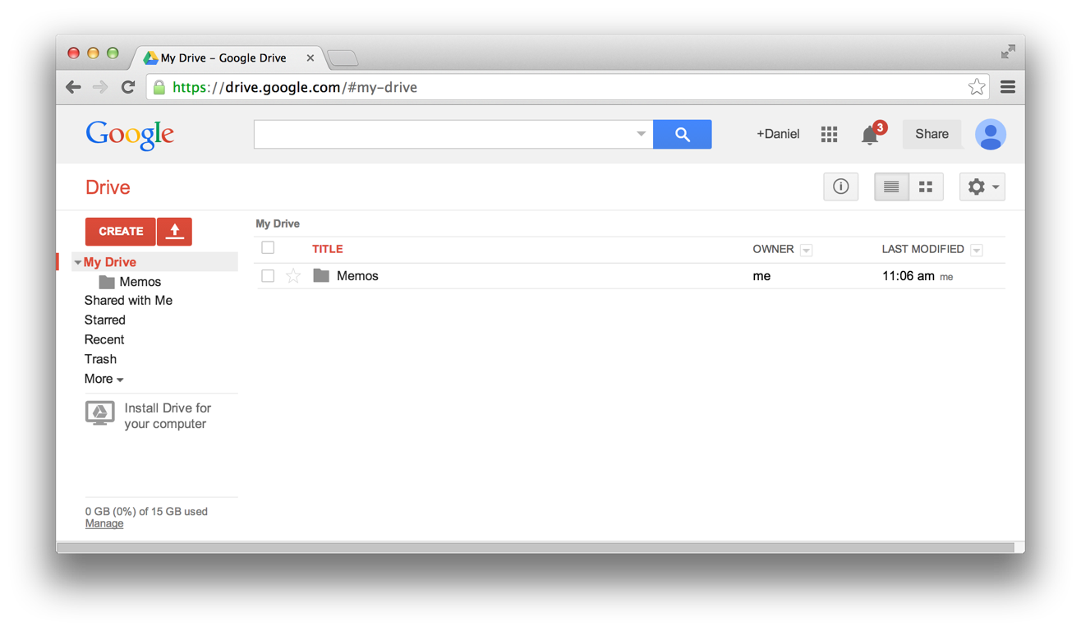
UI Hall of Fame or Shame?
Notes:
Consider the web interface for Google Drive. Analyze its usability with respect to:
- Graphical layout: the squint test, visual variables, spacing, etc.
- Adherence to user interface conventions
- Simplicity (what functionality is offered, how simply is it expressed?)
- Learnability and efficiency; information scent

Slide 3
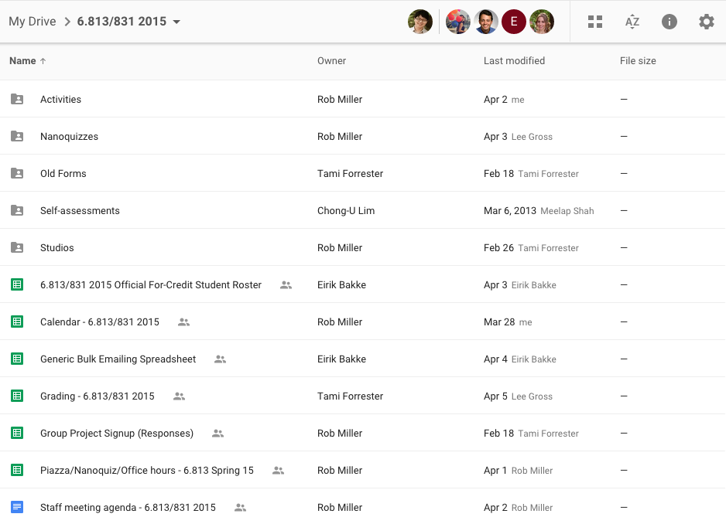
UI Hall of Fame or Shame?

Slide 4
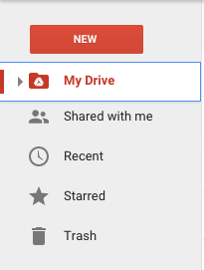
UI Hall of Fame or Shame?
vs

Slide 5
Nanoquiz
closed book, closed notes
3 minutes (timer in upper right)
if you can’t use the online form, use paper
close your laptop when you’re done

Slide 6
0:04
0:09
0:08
0:07
0:05
0:03
0:02
0:01
0:00
0:14
3:00
2:30
2:00
1:45
1:30
1:15
1:00
0:45
0:30
0:20
0:19
0:18
0:17
0:16
0:15
0:13
0:12
0:11
0:10
0:06
Which of the following are correct about readability? (choose all good answers) A. In a fixation, a reader can recognize only a single word at a time. B. A saccade is an abrupt jump to the next fixation point. C. While reading, the eye moves steadily along a line of text.
Which of the following are always true of a 12-point font? (choose all good answers) A. x-height is 12 points. B. In print, it occupies 1/6 of an inch vertically. C. To render the exact size in CSS, you need to set font size to 12ex. D. To render the exact size in CSS, you need to set font size to 12px.
Which of the following are correct about whitespace? (choose all good answers) A. Kerning can be alternatively referred to as tracking. B. 12/12 is analogous to double-spacing. C. Changing the leading changes the value of a body text.
Notes:
. Legibility refers to the effectiveness of the whole reading process.

Slide 7
Learning Objectives
Identify reasons why typography matters in user interface design.
Discuss design considerations related to readability.
Practice and justify font selection.

Slide 8
Why Does Typography Matter?
Art and science of displaying text
Font
Spacing

Slide 9
Why Does Typography Matter?
Identity: convey meaning
Readability
Appropriateness
Affect
Aesthetics
Safety

Slide 10
Identity: Serif vs Sans-Serif

Slide 11
Identity: Serif vs Sans-Serif

Slide 12
Brand Identity: Which do you like?

Slide 13
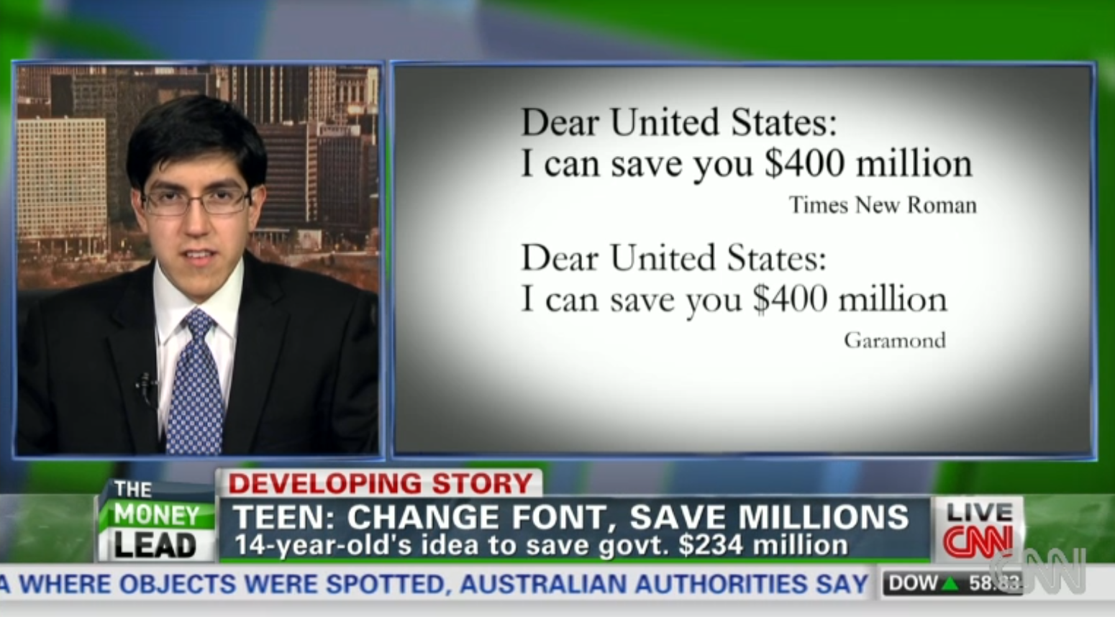
Save Money?
"Ink is two times more expensive than French perfume by volume,"
Notes:
http://www.cnn.com/2014/03/27/living/student-money-saving-typeface-garamond-schools/

Slide 14
German Font Debate: Antiqua vs Franktur

Slide 15
Readability
Fixations + Saccades + Comprehension
Speed reading
Skimming (skip certain words)
Meta guiding (finger to guide eyes)
RSVP (Rapid Serial Visual Presentation)
Better presentation
Spacing
Font

Slide 16
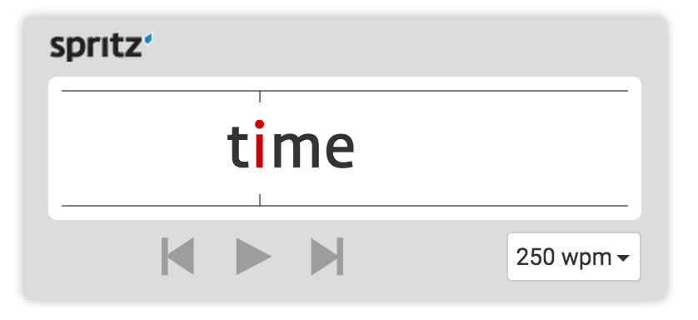
Speed Reading: Does it work?

Slide 17
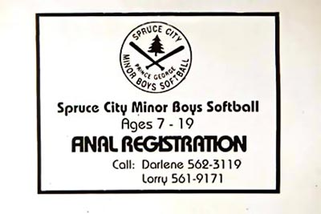
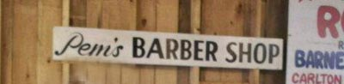
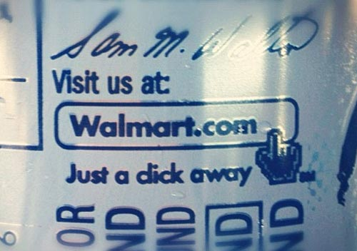
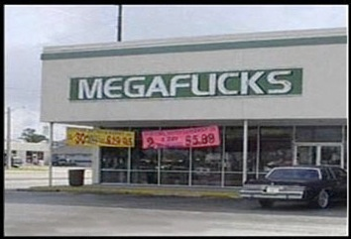
Watch Out for Bad Kerning
Notes:
https://courses.csail.mit.edu/6.831/form/form.py?formkey=17h0rY-WLfZ5t4-K45crhh_f7YsO4QbqIb8RibZ6WIVk

Slide 18
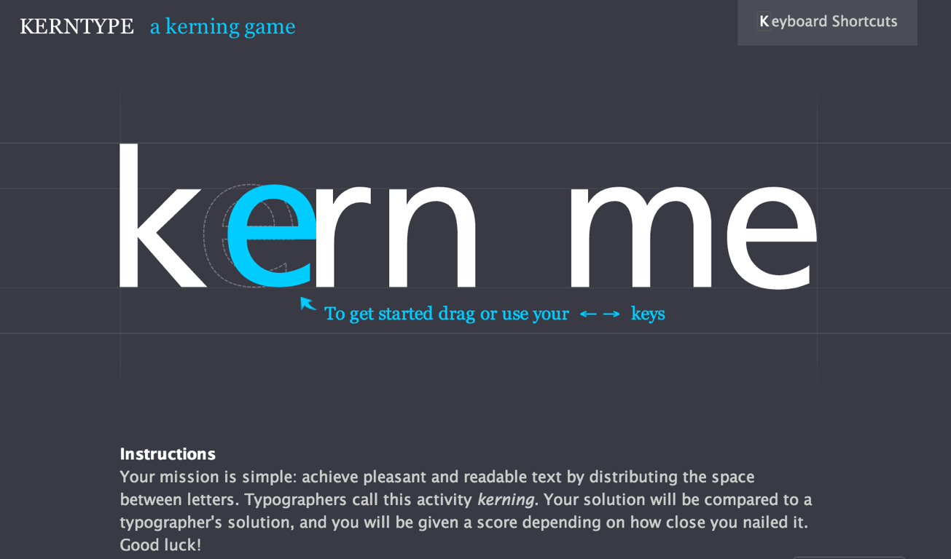
Try Out Your Kerning Skills
type.method.ac
Notes:
https://courses.csail.mit.edu/6.831/form/form.py?formkey=17h0rY-WLfZ5t4-K45crhh_f7YsO4QbqIb8RibZ6WIVk

Slide 19
Activity: Improving Readability
Adjust the CSS properties
font and spacing
shoutkey.com/splendid
Notes:
http://courses.csail.mit.edu/6.831/2015/inclass/17-typography/activities/ac17.shtml

Slide 20
Is Comic Sans Really Bad?
Times New Roman
classic
standard, plain, reliable, clear
Comic Sans
fun, breezy, silly, lazy, informal

Slide 21
Is Comic Sans Really Bad?
http://comicsansproject.tumblr.com/

Slide 22
Is Comic Sans Really Bad?

Slide 23
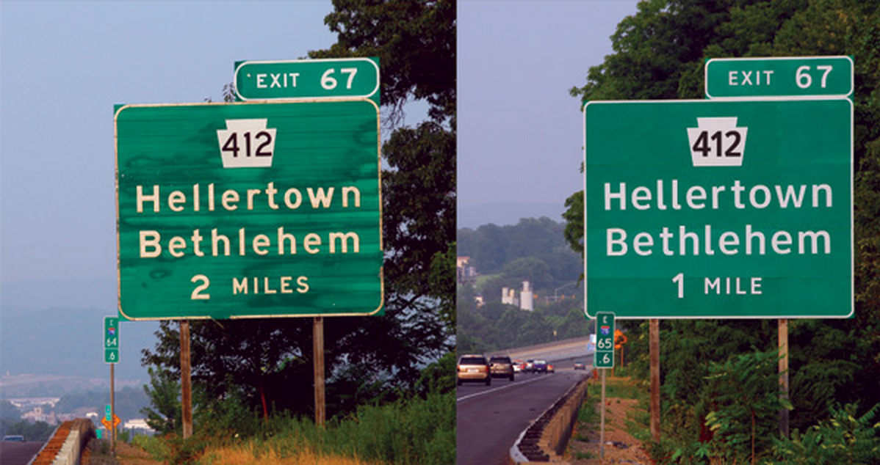
Case Study: Highway Gothic vs Clearview

Slide 24
Activity: Selecting a Font
pick a typeface for your classmates’ projects
you’ll get a random project
reload 3 times, to do 3 projects
shoutkey.com/jetty
Notes:
http://courses.csail.mit.edu/6.831/2015/inclass/17-typography/activities/ac17-logo.shtml

Slide 26
0:04
0:09
0:08
0:07
0:05
0:03
0:02
0:01
0:00
0:14
3:00
2:30
2:00
1:45
1:30
1:15
1:00
0:45
0:30
0:20
0:19
0:18
0:17
0:16
0:15
0:13
0:12
0:11
0:10
0:06
Which of the following are correct about readability? (choose all good answers) A. In a fixation, a reader can recognize only a single word at a time. B. A saccade is an abrupt jump to the next fixation point. C. While reading, the eye moves steadily along a line of text.
Which of the following are always true of a 12-point font? (choose all good answers) A. x-height is 12 points. B. In print, it occupies 1/6 of an inch vertically. C. To render the exact size in CSS, you need to set font size to 12ex. D. To render the exact size in CSS, you need to set font size to 12px.
Which of the following are correct about whitespace? (choose all good answers) A. Kerning can be alternatively referred to as tracking. B. 12/12 is analogous to double-spacing. C. Changing the leading changes the value of a body text.

